Slide 1

CSE3251
Computer Networks
Dr. Asif Zaman
Professor, CSE, RU

Slide 2
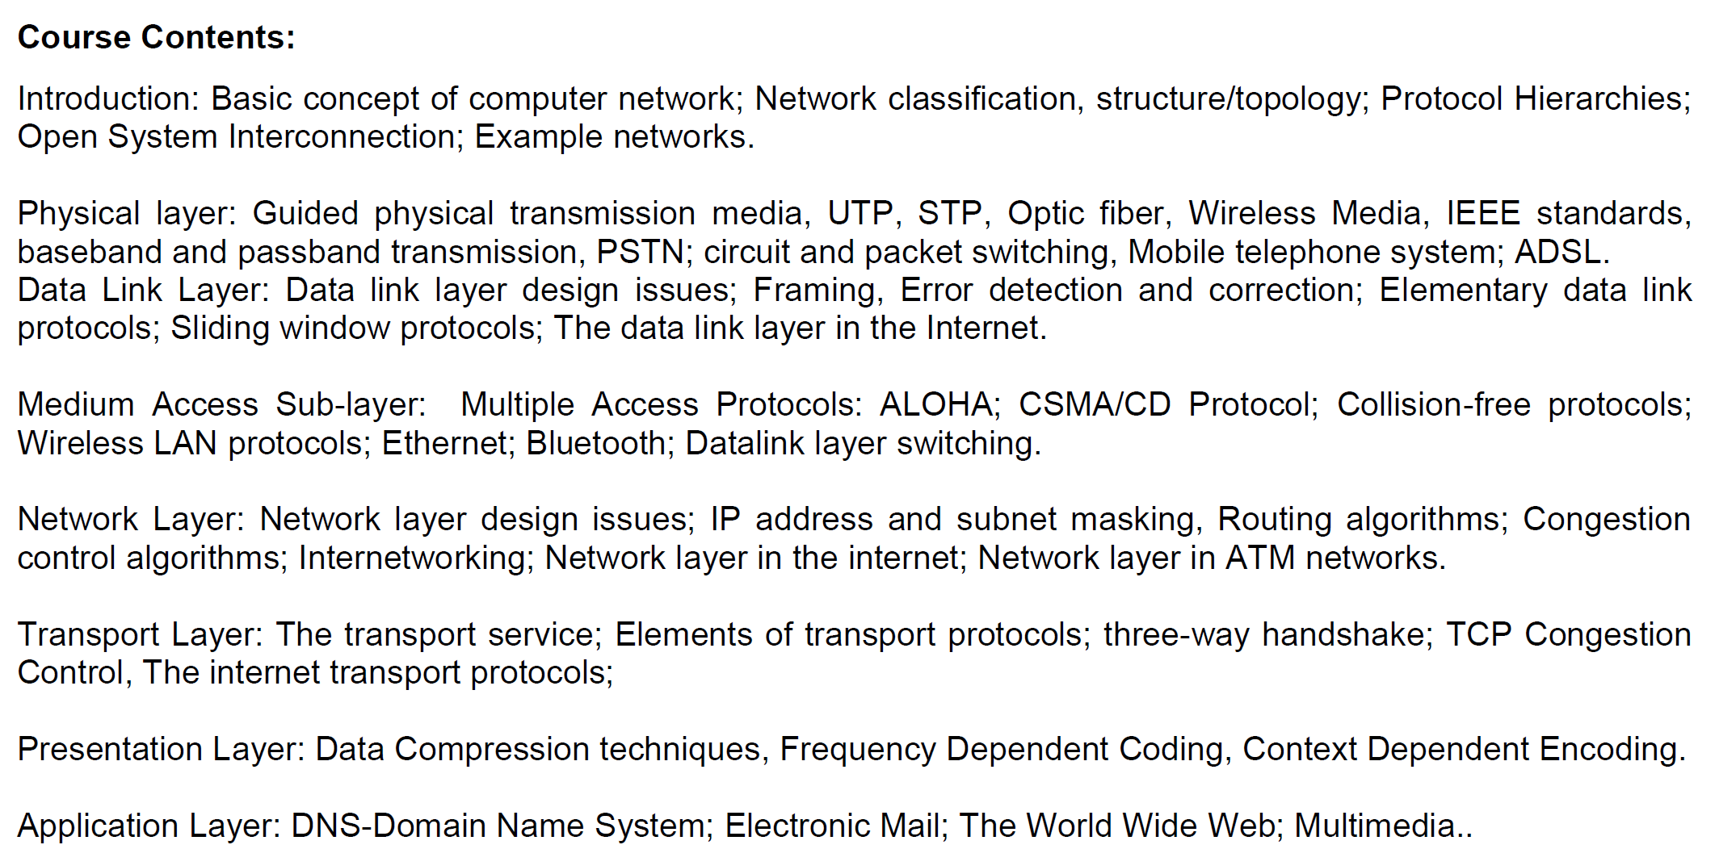

Slide 3
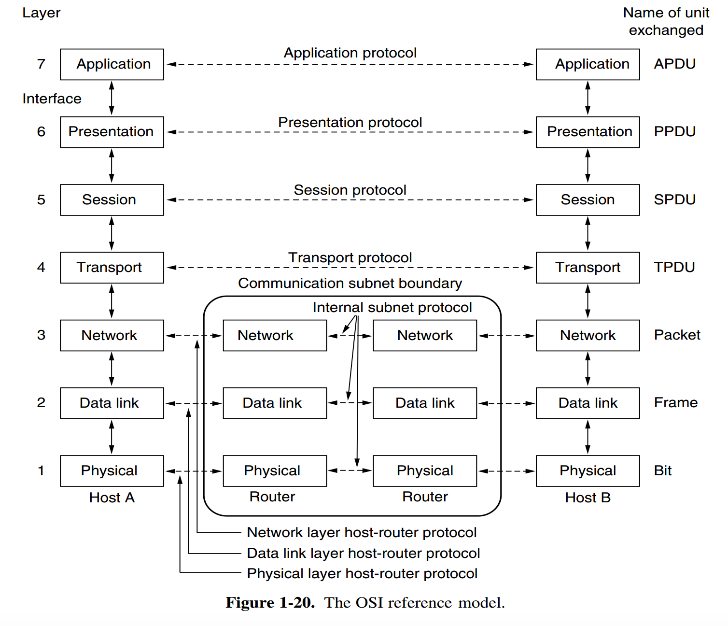
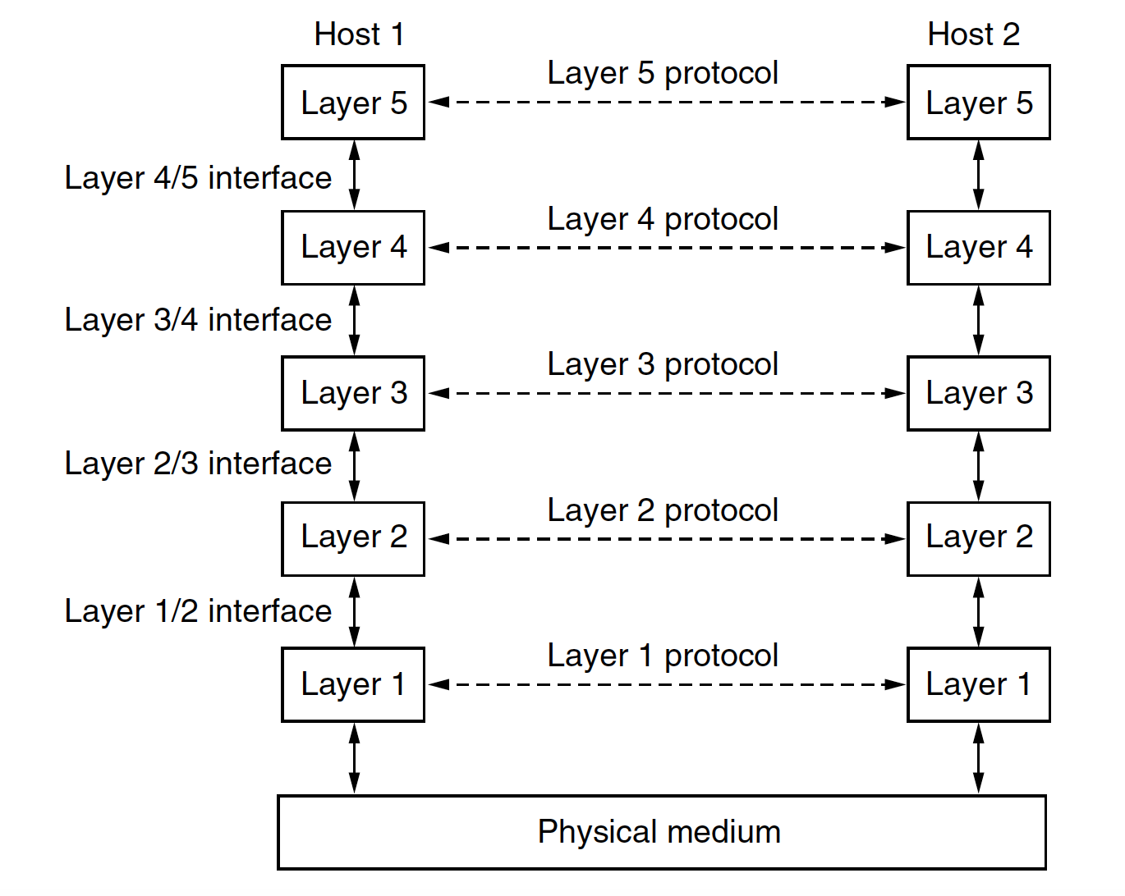
OSI Reference Model
All People Seem To Need Data Processing

Slide 4
The Physical Layer
The physical layer is concerned with transmitting raw bits over a communication channel.
The design issues have to do with making sure that
when one side sends a 1 bit it is received by the other side as a 1 bit, not as a 0 bit.
what electrical signals should be used to represent a 1 and a 0,
how many nanoseconds a bit lasts,
whether transmission may proceed simultaneously in both directions,
how the initial connection is established,
how it is torn down when both sides are finished,
how many pins the network connector has, and
what each pin is used for.

Slide 5
1. Introduction to the Physical Layer
- OSI Model
- Characteristics of Signals: Analog vs. digital signals.
2. Data Representation
- Data Encoding and Modulation Techniques:
- Digital-to-Digital Encoding: NRZ, Manchester, and differential Manchester.
- Analog-to-Digital Conversion: Sampling, quantization, and encoding (PCM, Delta Modulation).
- Digital-to-Analog Modulation: ASK, FSK, PSK, QAM.
- Analog-to-Analog Modulation: AM, FM, PM.
- Line Coding and Properties: DC bias, bandwidth, synchronization.
3. Transmission Media
- Guided Media:
- Twisted pair cables: UTP, STP, categories, and use cases.
- Coaxial cables.
- Fiber optics: Structure, light propagation, advantages, and types (single-mode, multimode).
- Unguided Media:
- Radio waves, microwaves, and infrared.
- Characteristics like range, frequency, and attenuation.
4. Signal Transmission Concepts
- Transmission Impairments: Attenuation, distortion, noise (thermal, intermodulation, crosstalk).
- Channel Capacity:
- Nyquist Bit Rate.
- Shannon Capacity.
- Bandwidth, Throughput, and Latency: Definitions and interrelations.
5. Multiplexing and Switching
- Multiplexing Techniques:
- Time Division Multiplexing (TDM).
- Frequency Division Multiplexing (FDM).
- Wavelength Division Multiplexing (WDM).
- Code Division Multiplexing (CDM).
- Switching Techniques:
- Circuit switching, packet switching, and message switching.
6. Physical Layer Devices
- Introduction to Hardware:
- Network interface cards (NICs).
- Repeaters, hubs, and their roles.
- Transceivers and modems.
7. Error Detection and Correction Basics
- Noise-induced errors in physical layer transmission.
- Basic error correction mechanisms like parity checks and Hamming code.
8. Synchronization
- Bit-level and clock synchronization.
- Techniques for ensuring sender and receiver are synchronized (e.g., clock recovery techniques).
9. Transmission Modes
- Simplex, Half-Duplex, and Full-Duplex: Concepts and examples.
- Serial vs. Parallel Communication.
10. Network Topologies and Physical Layer Standards
- Common physical layer topologies: Star, bus, ring, and mesh.
- Standards like IEEE 802.3 (Ethernet), IEEE 802.11 (Wi-Fi), and others relevant to physical communication.

Slide 6
Physical Layer
Transmission medium
Guided Transmission Medium
Unguided Transmission Medium
Switching
Circuit switching
Packet Switching

Slide 7
Switching
Switching ????
Switching is the practice of directing a signal or data element toward a particular hardware destination.
Two types:
Circuit switching
Packet Switching

Slide 8
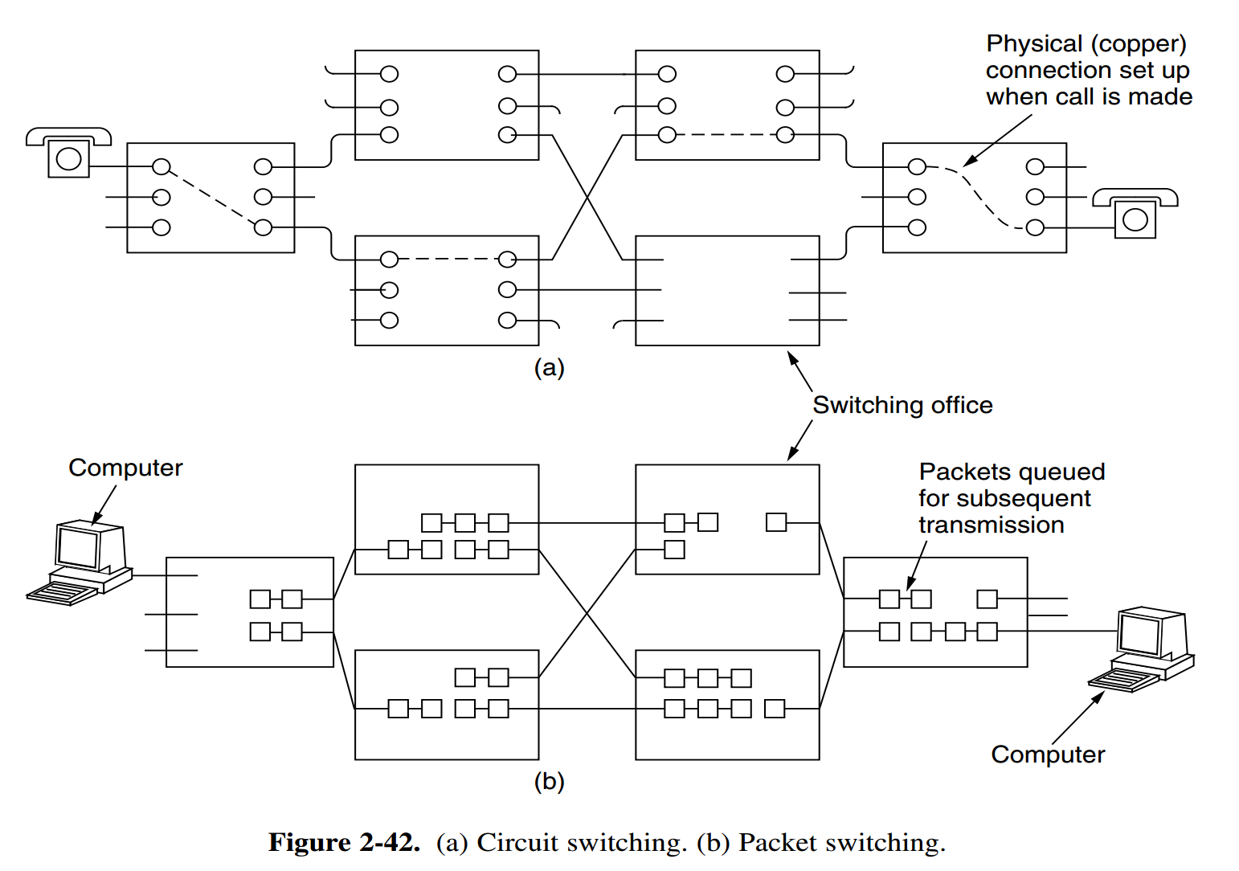
Switching

Slide 9
Switching
Switching Comparison
Circuit switching vs Packet Switching

Slide 10
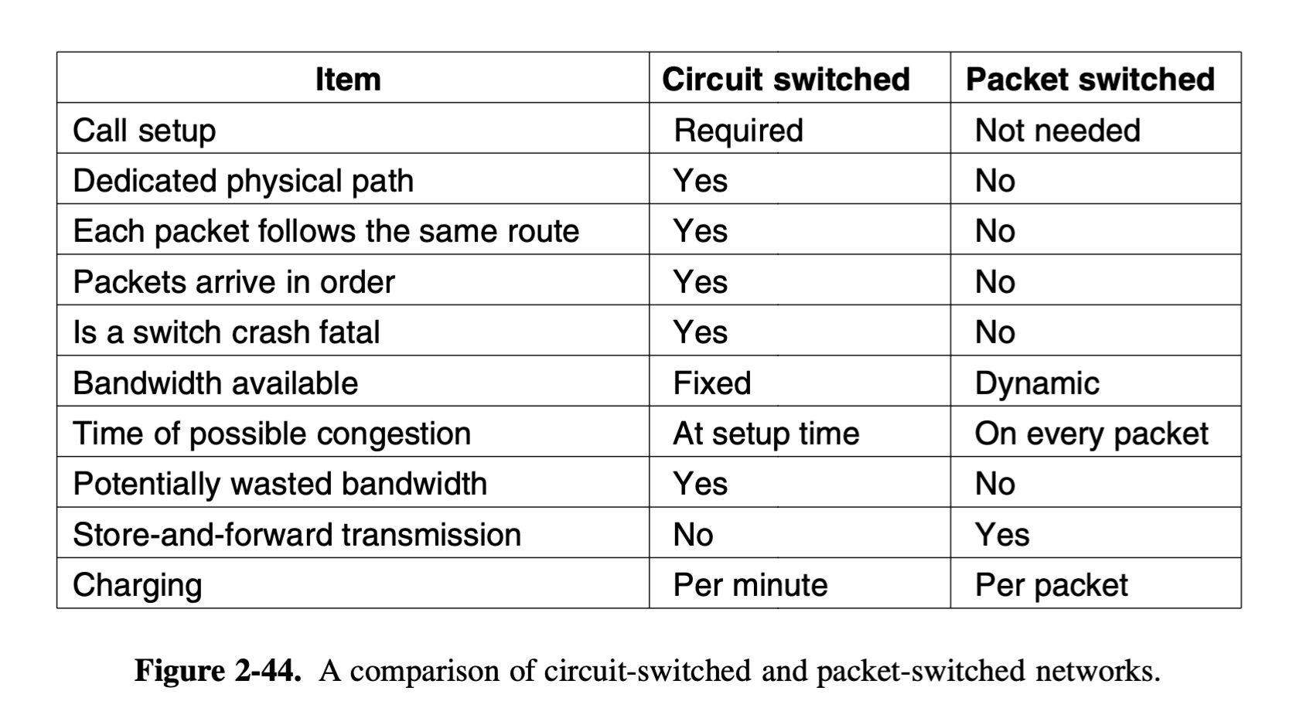
Switching

Slide 11
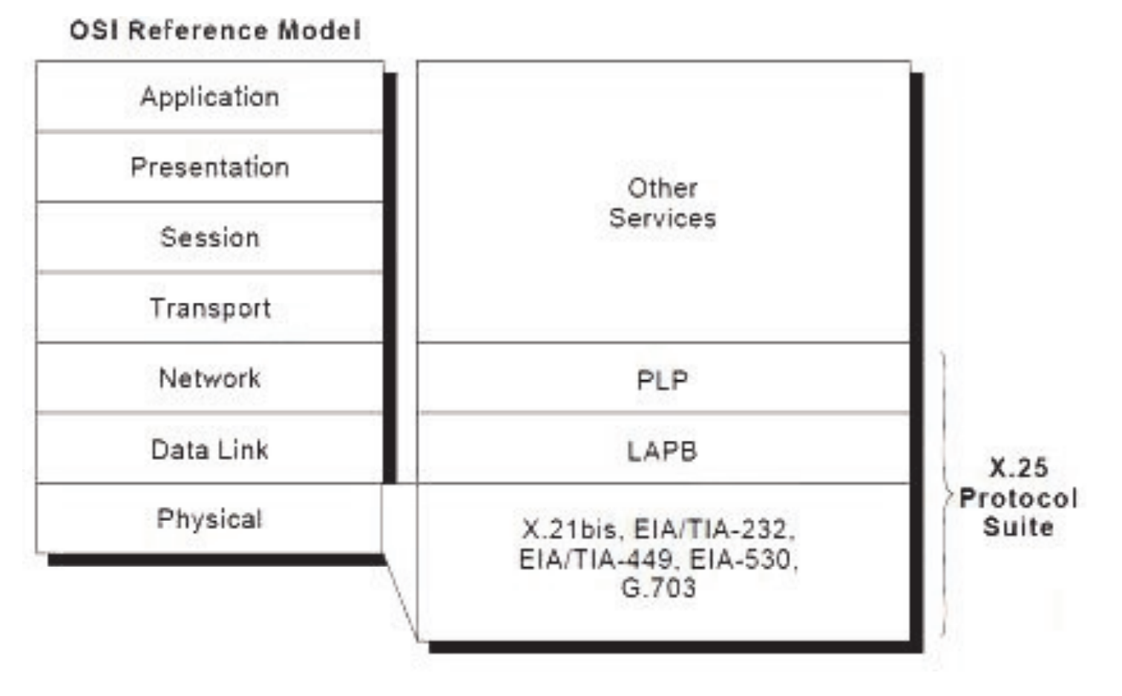
X.25 Protocol
… 1970s by ITU-T
ITU Telecommunication Standardization Sector (ITU-T)
ITU: International Telecommunication Union (ITU)
PLP: Packet Layer Protocol
LAP-B: Link Access Protocol - Balanced

Slide 12
X.25 Protocol
X.25 network devices … categories:
Data Terminal Equipment (DTE),
Data Circuit-terminating Equipment (DCE),
Packet-switching Exchange (PSE)
PAD- Packet Assembler/ Dissembler.

Slide 13
X.25 Protocol

Slide 14
DTE
Data terminal equipment devices are end systems that communicate across the X.25 network.
They are usually
Terminals,
personal computers, or network hosts,
and are located on the premises of individual subscribers.

Slide 15
DCE
DCE devices are communications devices, such as Modems and packet switches, that provide the interface between DTE devices and a PSE, and are generally located in the carrier's facilities.
PSEs are switches that compose the bulk of the carrier’s network.
They transfer data from one DTE device to another through the X.25 PSN.

Slide 16
Packet Assembler/Disassembler (PAD)
The packet assembler/disassembler (PAD) is a device commonly found in X.25 networks.
The PAD is located between a DTE device and a DCE device, and
it performs three primary functions:
Buffering (storing data until a device is ready to process it),
Packet assembly,
Packet disassembly.

Slide 17
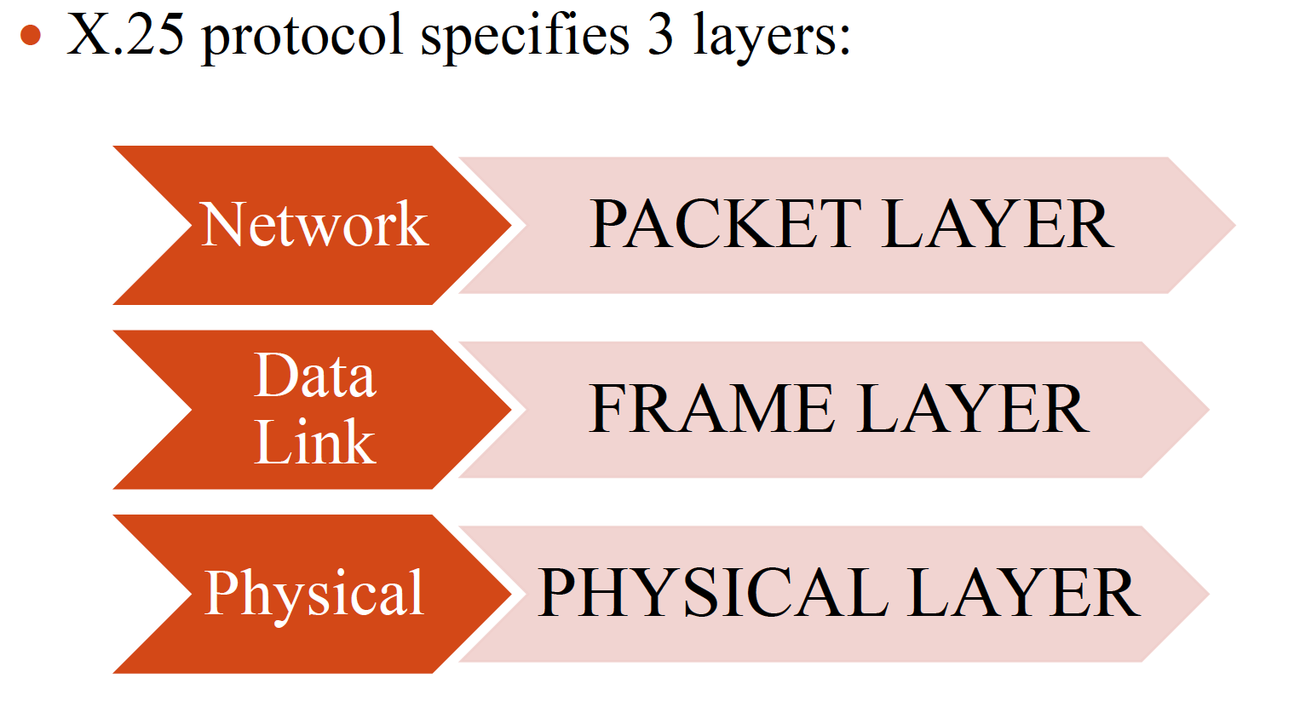
X.25 Protocol

Slide 18
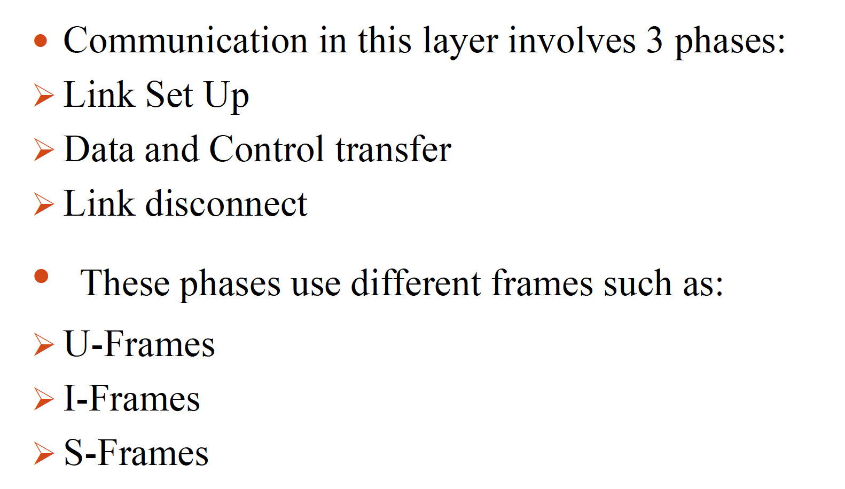
X.25 Protocol

Slide 19
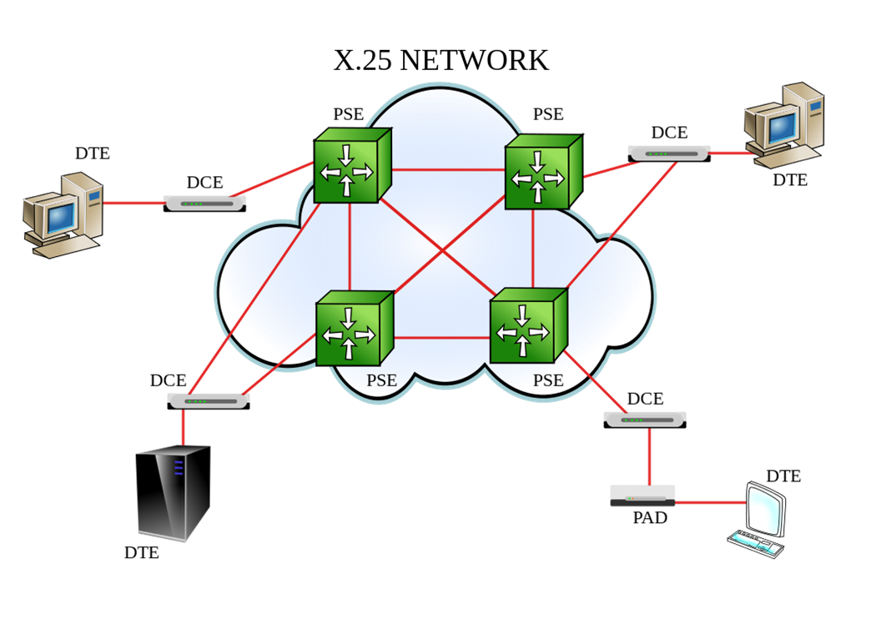
X.25 Protocol
U-frame is used to set up and disconnect the connection between DTE and DCE
I-frames ---data transfer
S-frame is used for error control and flow control

Slide 20
virtual circuits in X.25
Two types of virtual circuit exists in x.25
Switched virtual circuits (SVCs)
Permanent virtual circuit (PVCs)

Slide 21
SVC & PVC
Switched virtual circuits (SVCs) are:
temporary connections used for irregular data transfers.
They require that two DTE devices establish, maintain, and terminate a session each time the devices need to communicate.

Slide 22
SVC & PVC
Permanent virtual circuits (PVCs) are:
…for frequent and consistent data transfers.
… do not require … sessions … established & terminated.
…DTEs … begin transferring data whenever necessary because the session is always active

Slide 23
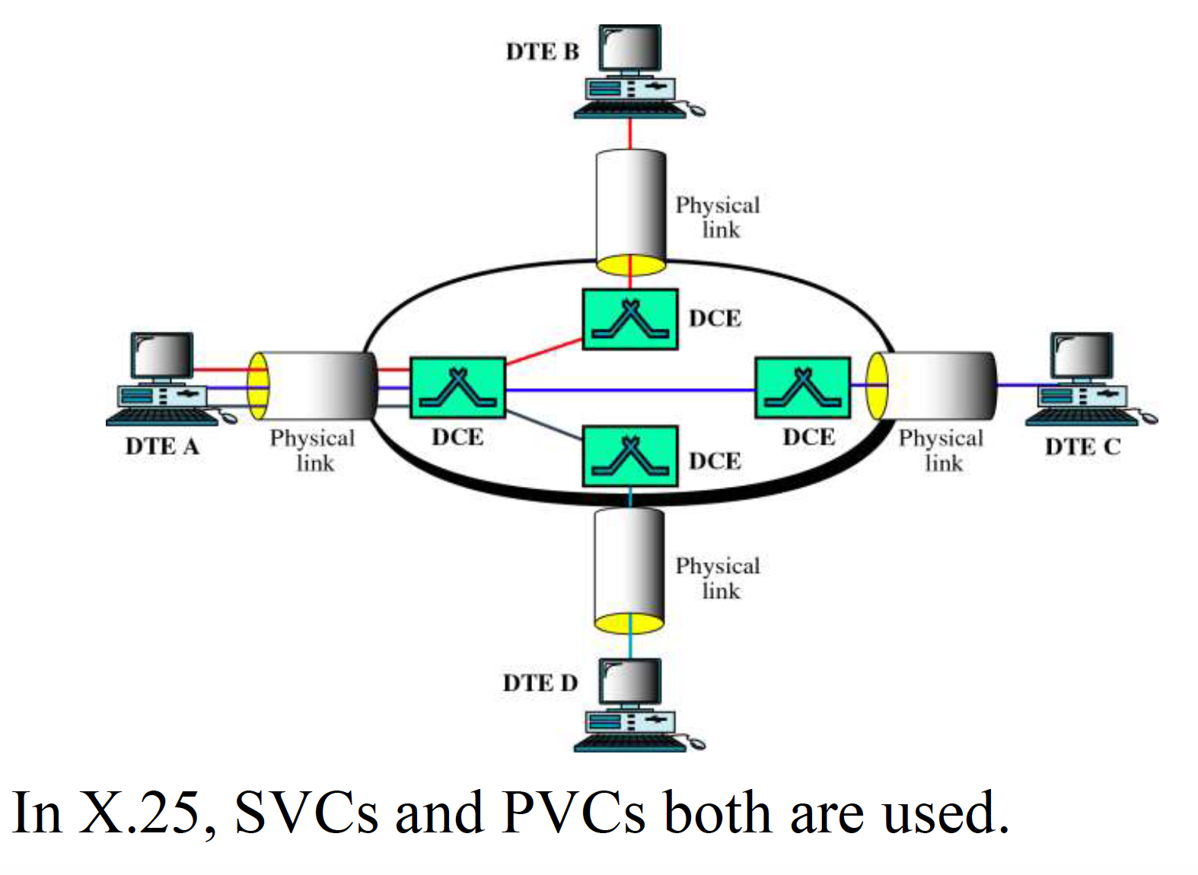

Slide 24
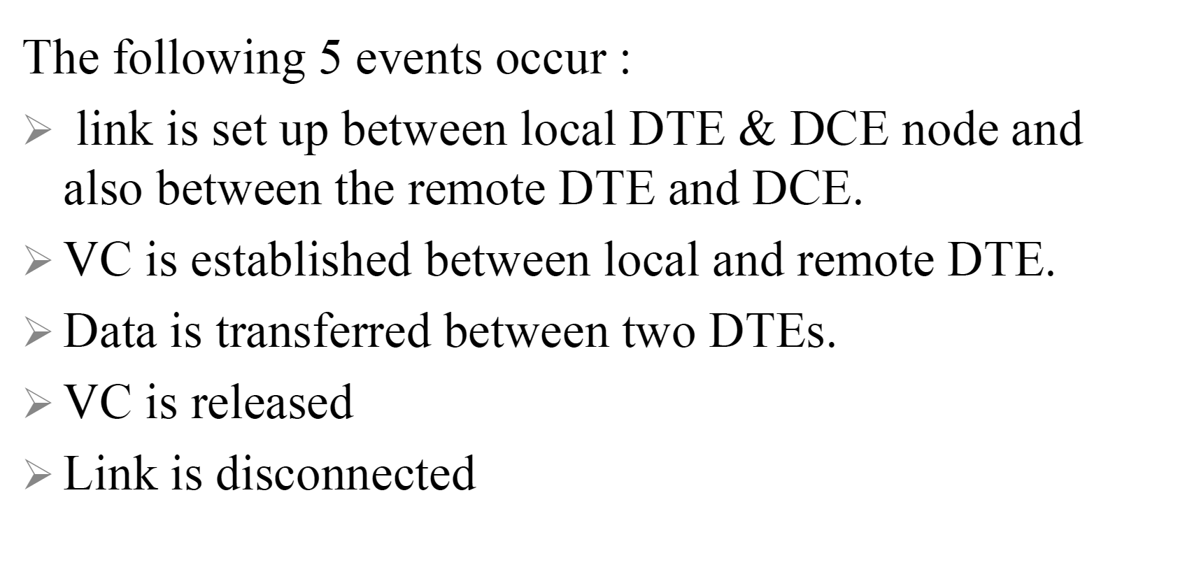

Slide 25
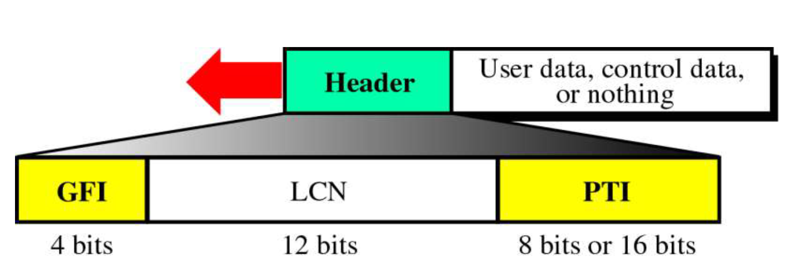
PLP Packet
GFI or General Format Identifier is a 4 bit field.
(whether it is data or control information)
LCN- Logical Channel Number
PTI or Packet Type Identifier defines the type of packet, viz. data packet or control packet. (17 different types).

Slide 26
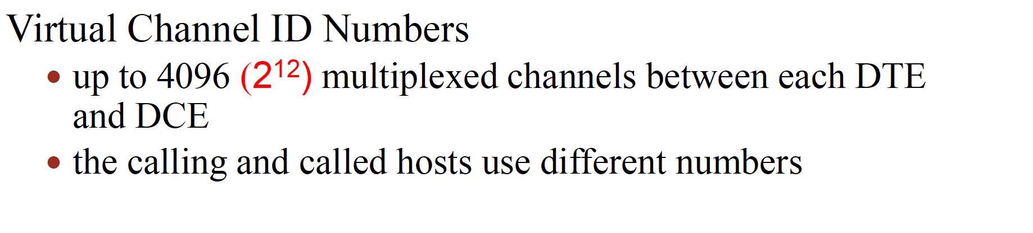
PLP Packet

Slide 27
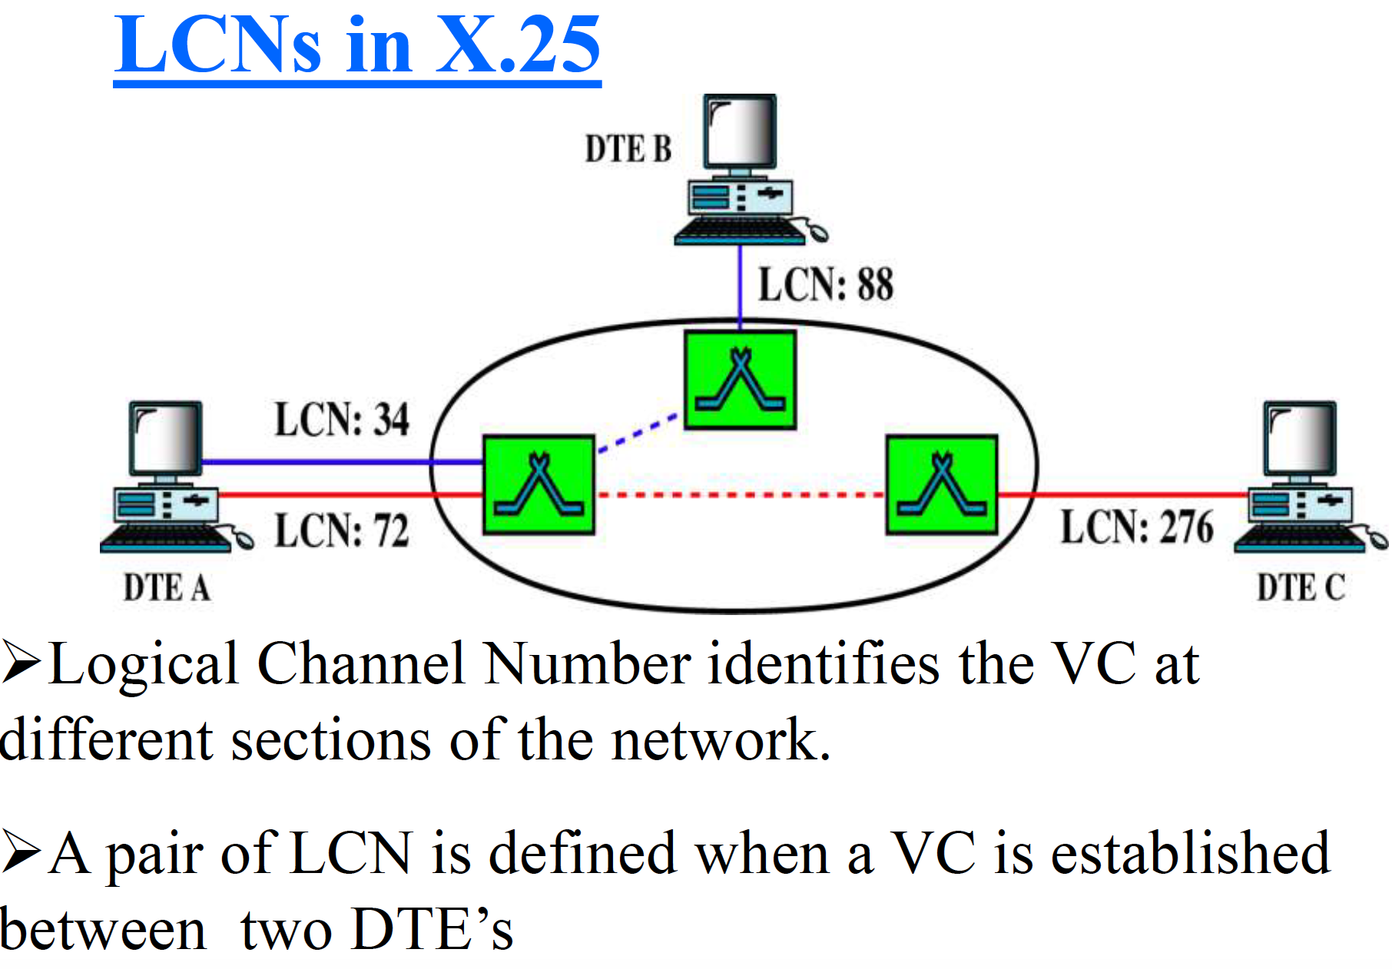

Slide 28
Mobile Phone System
Mobile phones should not be confused with cordless phones
…. it is interesting to note how political and tiny marketing decisions can have a huge impact.

Slide 29
US vs Europe
Purchased in California also worked in New York
Europe, every country devised its own system, which resulted in a fiasco.
In the U.S., mobile phones are mixed in with regular (fixed) telephones – (212) 234-5678
In Europe, mobile phone numbers have a special area code (analogous to 800 and 900 numbers)
…prepaid mobile phones in Europe (up to 75% in some areas).

Slide 30
Mobile Phone System
Mobile phones (sometimes called cell phones) three distinct generations, widely called 1G, 2G, and 3G. The generations are:
Analog voice.
Digital voice.
Digital voice and data (Internet, email, etc.)

Slide 31
First-Generation (1G) Mobile Phones: Analog Voice
In 1946, the first system for car-based telephones was set up in `.
…single large transmitter on top of a tall building +
had a single channel, used for both sending and receiving.
push-to-talk systems
In the 1960s, IMTS (Improved Mobile Telephone System)
IMTS supported 23 channels … from 150 MHz to 450 MHz.

Slide 32
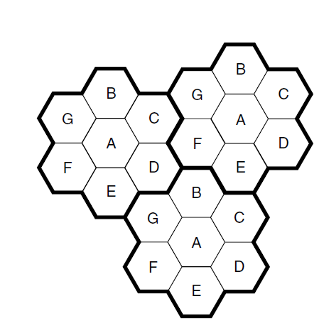
Advanced Mobile Phone System (AMPS)- Bell labs
Installed in 1982
Europe – TACS
Japan – MCS-L1
Retired 2008
A geographic region is divided up into cells
In AMPS, the cells are typically 10 to 20 km across;
in digital systems, the cells are smaller
The key idea that gives cellular systems more capacity than previous systems is the use of relatively small cells and the reuse of transmission frequencies in nearby (but nonadjacent) cells.

Slide 33
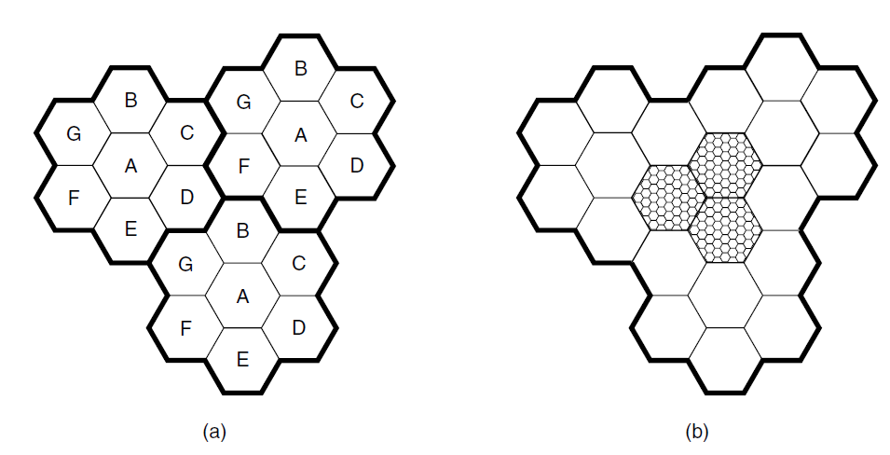
The cells are normally roughly circular, but they are easier to model as hexagons
They are grouped in units of seven cells.
Each letter indicates a group of frequencies.
Notice that for each frequency set, there is a buffer about two cells wide where that frequency is not reused, providing for good separation and low interference

Slide 34
At the center of each cell is a base station to which all the telephones in the cell transmit.
The base station consists of a computer and transmitter/receiver connected to an antenna.
In a small system, all the base stations are connected to a single device called an MSC (Mobile Switching Center) or MTSO (Mobile Telephone Switching Office).
In a larger one, several MSCs may be needed, all of which are connected to a second-level MSC, and so on.
The MSCs are essentially end offices as in the telephone system, and are in fact connected to at least one telephone system end office.

Slide 35
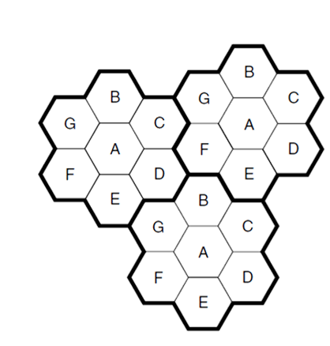
At any instant, each mobile telephone is logically in one specific cell and under the control of that cell’s base station.
When a mobile telephone physically leaves a cell ….
….the base station then transfers ownership to the cell getting the strongest signal;
The telephone is then informed of its new boss,…
This process, called handoff, takes about 300 msec.
Channel assignment is done by the MSC, the nerve center of the system.
The base stations are really just dumb radio relays.

Slide 36
AMPS uses FDM to separate the channels
..832 full-duplex channels,
…824 to 849 MHz are used for mobile to base station,
… 869 to 894 MHz are used for base station to mobile
…is 30 kHz wide
The 832 channels are divided into four categories
Control channels (base to mobile) are used to manage the system.
Paging channels (base to mobile) alert mobile users to calls for them.
Access channels (bidirectional) are used for call setup and channel assignment.
Finally, data channels (bidirectional) carry voice, fax, or data.

Slide 37
Second-Generation (2G) Mobile Phones: Digital Voice
1G: Analog voice 2G: Digital voice
It provides capacity gains by allowing voice signals to be digitized and compressed.
It improves security by allowing voice and control signals to be encrypted.
Finally, it enables new services such as text messaging
…no worldwide standardization during the second
DAMPS (Digital Advanced Mobile Phone System) - coexists with AMPS and uses TDM to place multiple calls on the same frequency channel

Slide 38
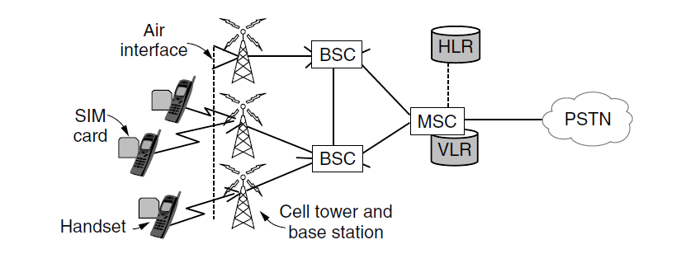
GSM (Global System for Mobile communications) –Europe
CDMA (Code Division Multiple Access) - US
SIM card, short for Subscriber Identity Module
BSC (Base Station Controller)
BTS - Base Transceiver Station
VLR (Visitor Location Register)- database of nearby mobiles that are associated with the cells it manages
HLR (Home Location Register) - a database in the mobile network that gives the last known location of each mobile.

